Slide 1


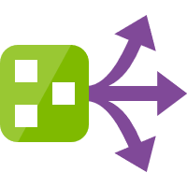
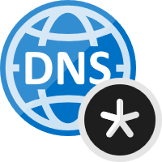





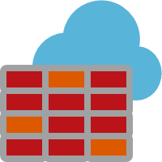


Azure Network - Firewall, Private Endpoint & Service Endpoint
Spoke VNet - App
Spoke VNet – Private Endpoint
VNet – 10.1.0.0/16
VNet – 10.2.0.0/16
Route Filters
Subnet – 10.1.0.0/24
10.0.0.4 → 10.2.0.16
privatelink.vaultcore.azure.net
Subnet – 10.2.0.0/24
Route Table
VNet Link
Auto-registered
VNet Link
Auto-registered
Private Link
NIC with Private IP from the Subnet is created & assigned to Key Vault
VM
Private Endpoint NIC
Key Vault
Azure DNS private zone Key Vault
20.38.149.196
10.1.0.4
10.2.0.4
10.1.0.4
NIC
NIC
NIC
VNet Link
Auto-registered
Hub VNet - Firewall
VNet – 10.0.0.0/16
Subnet – 10.0.0.0/24
AzureFirewallSubnet
VNet Peering
VNet Peering
Azure Firewall
10.0.0.4
Log analytics workspace
Service Endpoint

Slide 2
Before Private Link (External & Internal Name Resolution)
HOST: kv-pep-spokepep.vault.azure.net
IP: 20.38.149.196
Key Vault Name:
kv-pep-spokepep.vault.azure.net
After Private Link (External Name Resolution)
CNAME: kv-pep-spokepep.privatelink.vaultcore.azure.net
HOST: kv-pep-spokepep.vault.azure.net
IP: 20.38.149.196
After Private Link (Internal Name Resolution)
HOST: kv-pep-spokepep.privatelink.vaultcore.azure.net
IP: 10.2.0.4

Slide 3




Azure Network - Firewall, DNS, Private Endpoint & Service Endpoint
Authoritative DNS for vault.azure.net
Received Query: kv-pep-spokepep.vault.azure.net
Response: kv-pep-spokepep.privatelink.vaultcore.azure.net (CNAME)
Azure Private DNS Zone
privatelink.vaultcore.azure.net
4
Received Query: kv-pep-spokepep.privatelink.vaultcore.azure.net
Response: 10.2.0.4
3
2
VNet link
VNet link
VNet link
5
Azure Provided DNS
168.63.129.16
Azure Provided DNS
168.63.129.16
Spoke VNet - App
Azure Provided DNS
168.63.129.16
Hub VNet - Firewall
Spoke VNet – Private Endpoint
VNet – 10.1.0.0/16
VNet – 10.0.0.0/16
VNet – 10.2.0.0/16
Subnet – 10.1.0.0/24
6
Subnet – 10.0.0.0/24
AzureFirewallSubnet
Subnet – 10.2.0.0/24
1
Deny all traffic by default
8
Private Link
VNet Peering
VNet Peering
NIC with Private IP from the Subnet is created & assigned to Key Vault
VM
7
Traffic filtering rules allow inbound/outbound access
Private Endpoint NIC
Key Vault
NIC
10.1.0.4
Route Filters
Azure Firewall
20.38.149.196
10.0.0.4
10.2.0.4
NSG
10.0.0.4 → 10.2.0.16
NIC
1. Outbound key vault allowed
2. Outbound internet denied
Route Table
Service Endpoint
9
Traffic through service endpoint
Integrated with Azure Monitor for logging & analyzing traffic
Log analytics workspace
Key Vault
20.38.149.196

